Slide 1
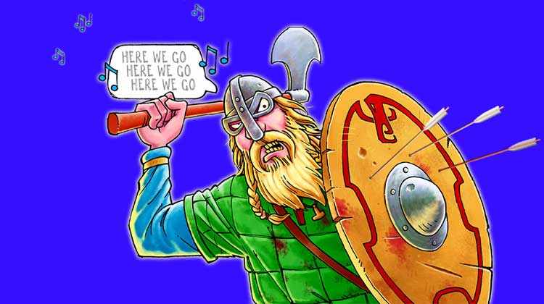
5 ‘O’ Productions Present
Horrible Histories :
The Voracious Vikings

Slide 2
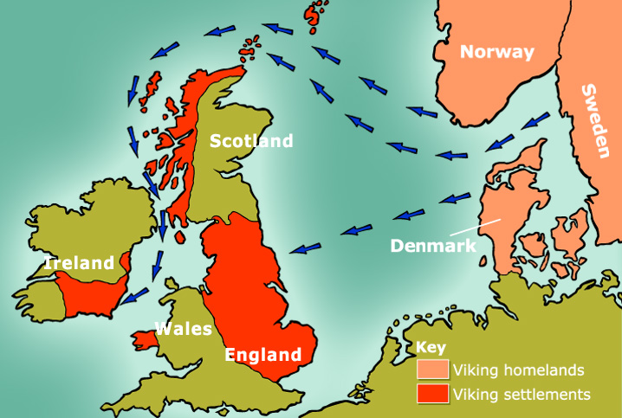
Where did the Vikings come from ?

Slide 3
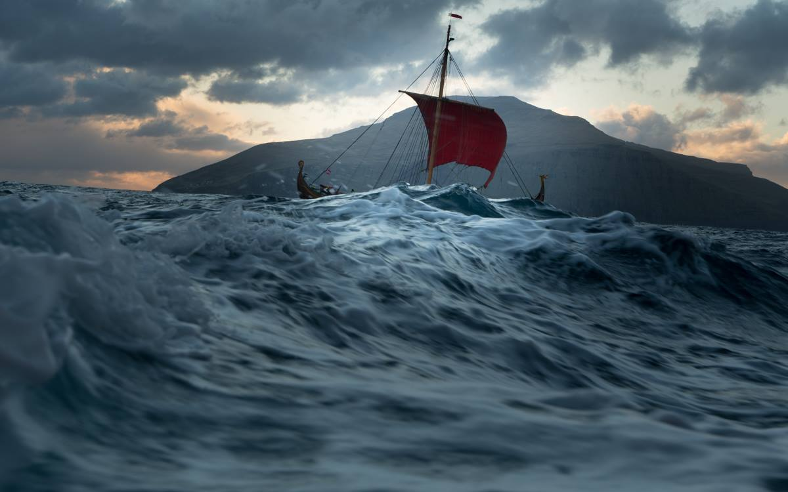
Why did they come to England ?

Slide 4
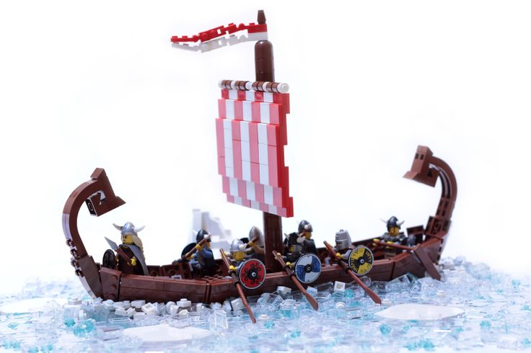
What were Viking ships like ?
(They were not made of Lego )

Slide 5
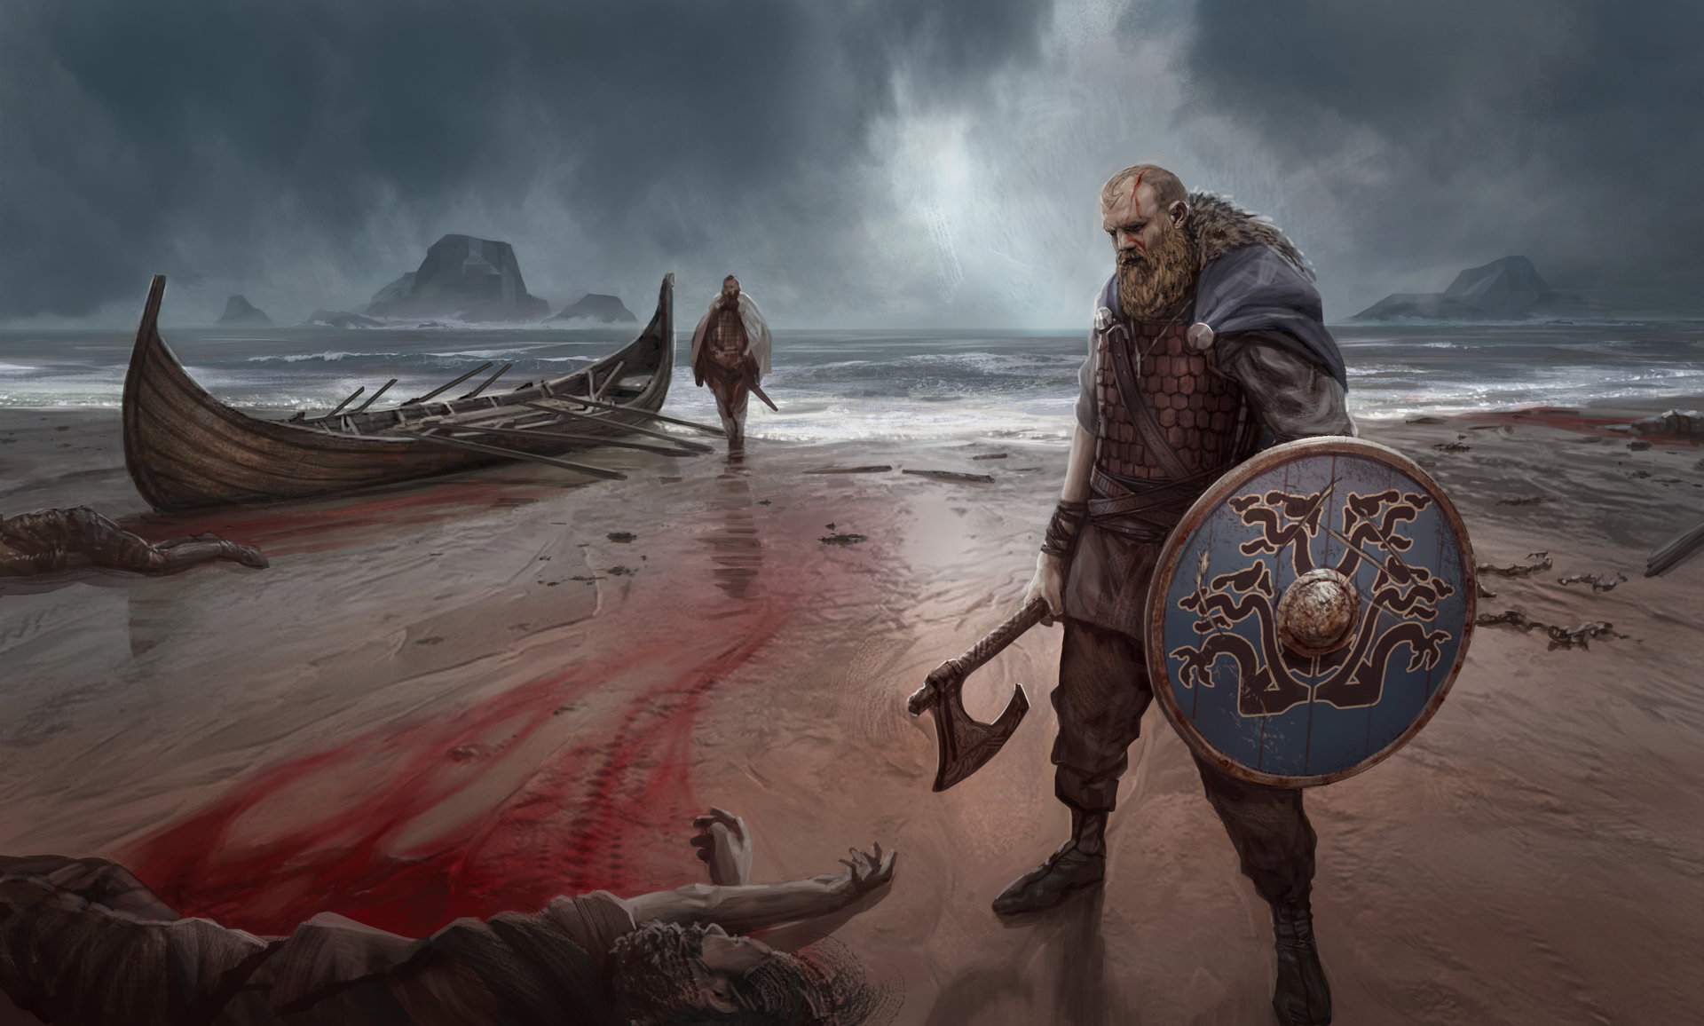
Were the Vikings just cold-blooded Killers ?

Slide 6
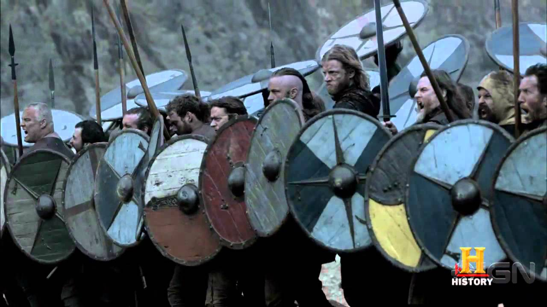
How did they fight ?
This is what 5’O’ look like on a wet and windy Friday afternoon.

Slide 7
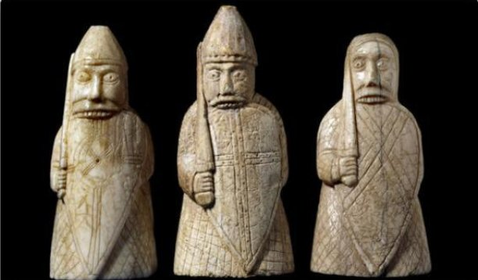
Why did some of the Vikings go into battle naked ?
Don’t try this at home

Slide 8
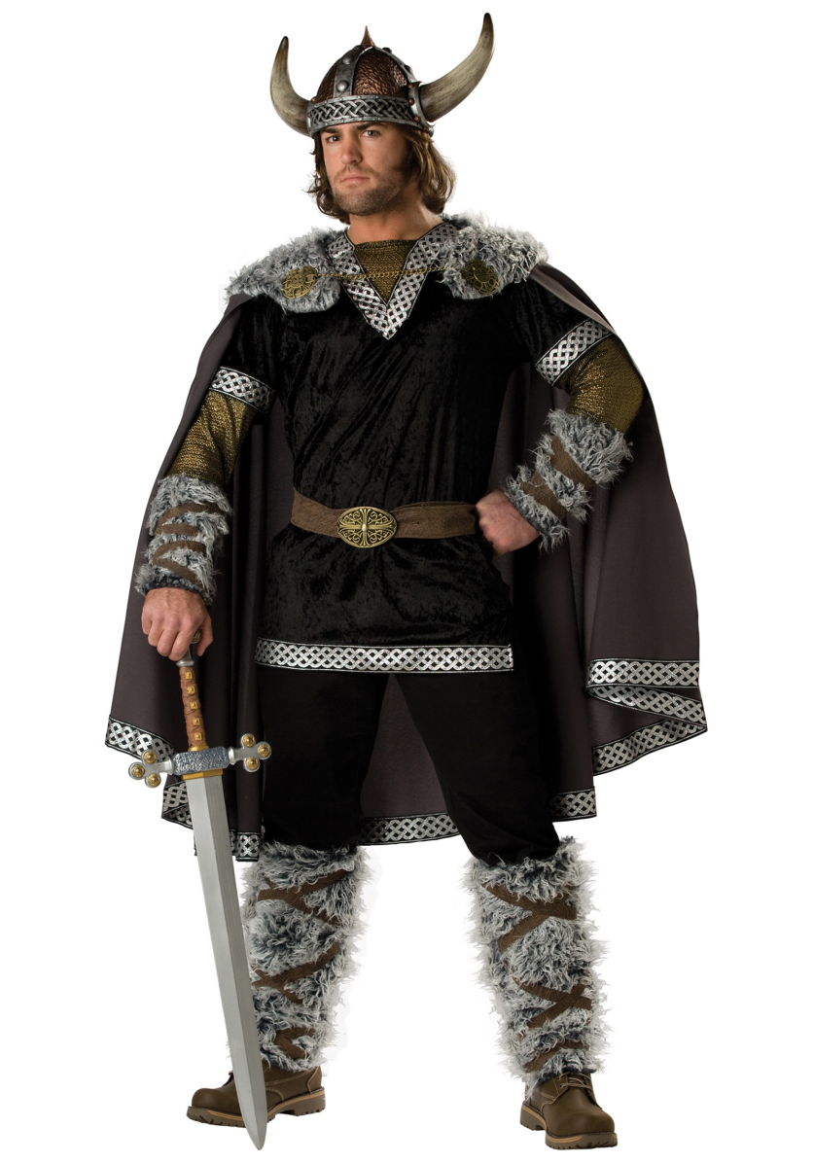
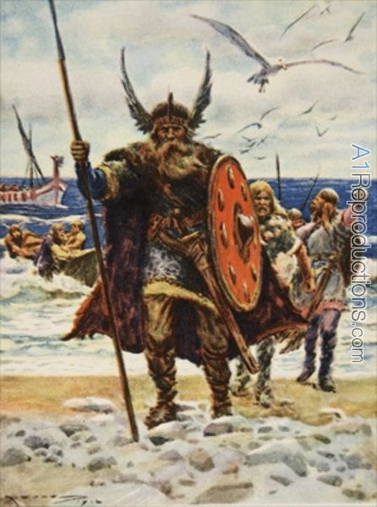
Did they have horns or wings on their helmets ?
No, no, no !

Slide 9
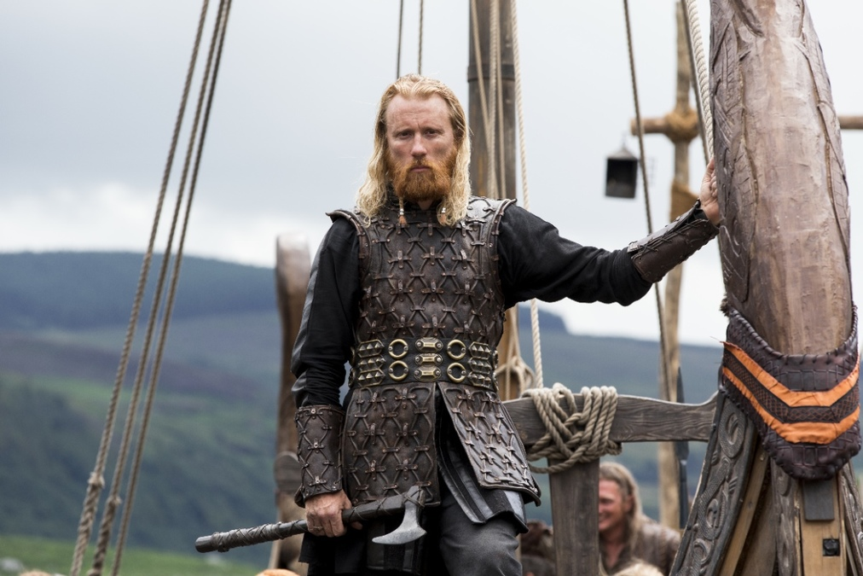
What was the blood eagle ?

Slide 10
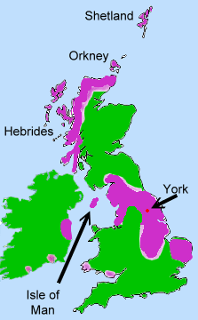
Where did they live in England ?
Football League
Division One: AD 871
Anglo - Saxons 1
Vikings 1
Calverton
.

Slide 11
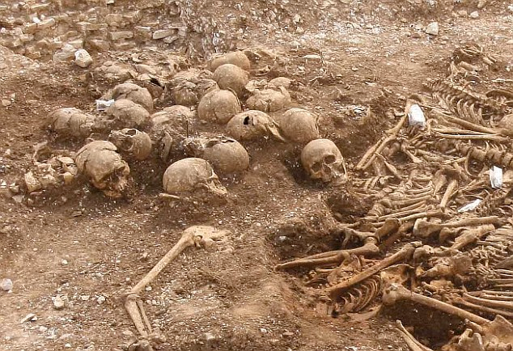
What did they believe happened when they died ?

Slide 12
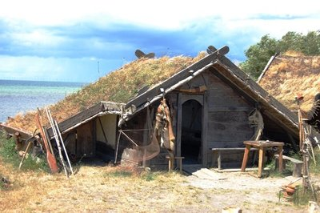
What were their houses like ?

Slide 13
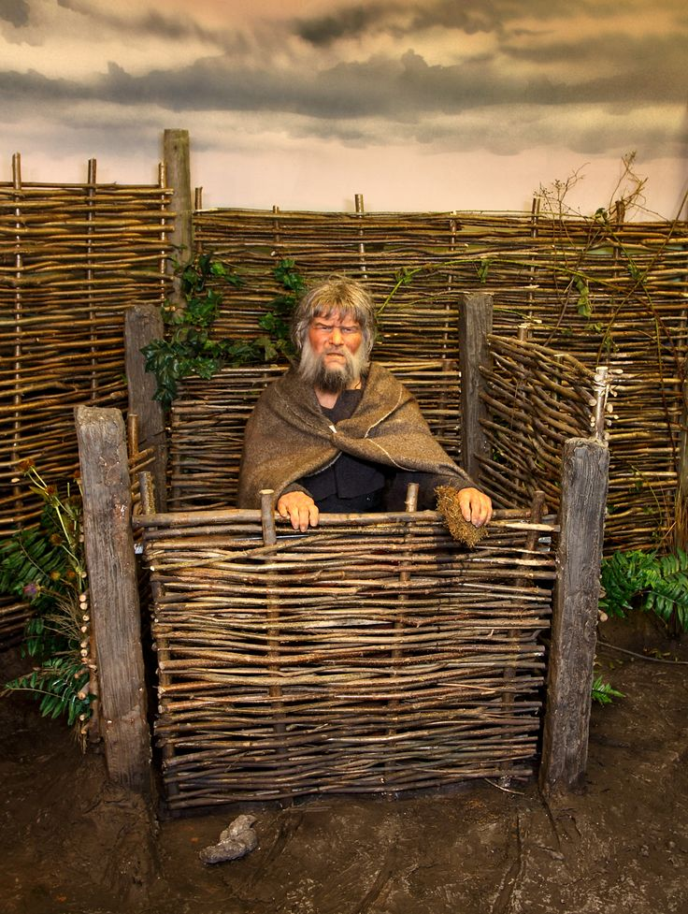

What did they wipe their bottoms with ?

Slide 14

How did the Vikings write ?

Slide 15
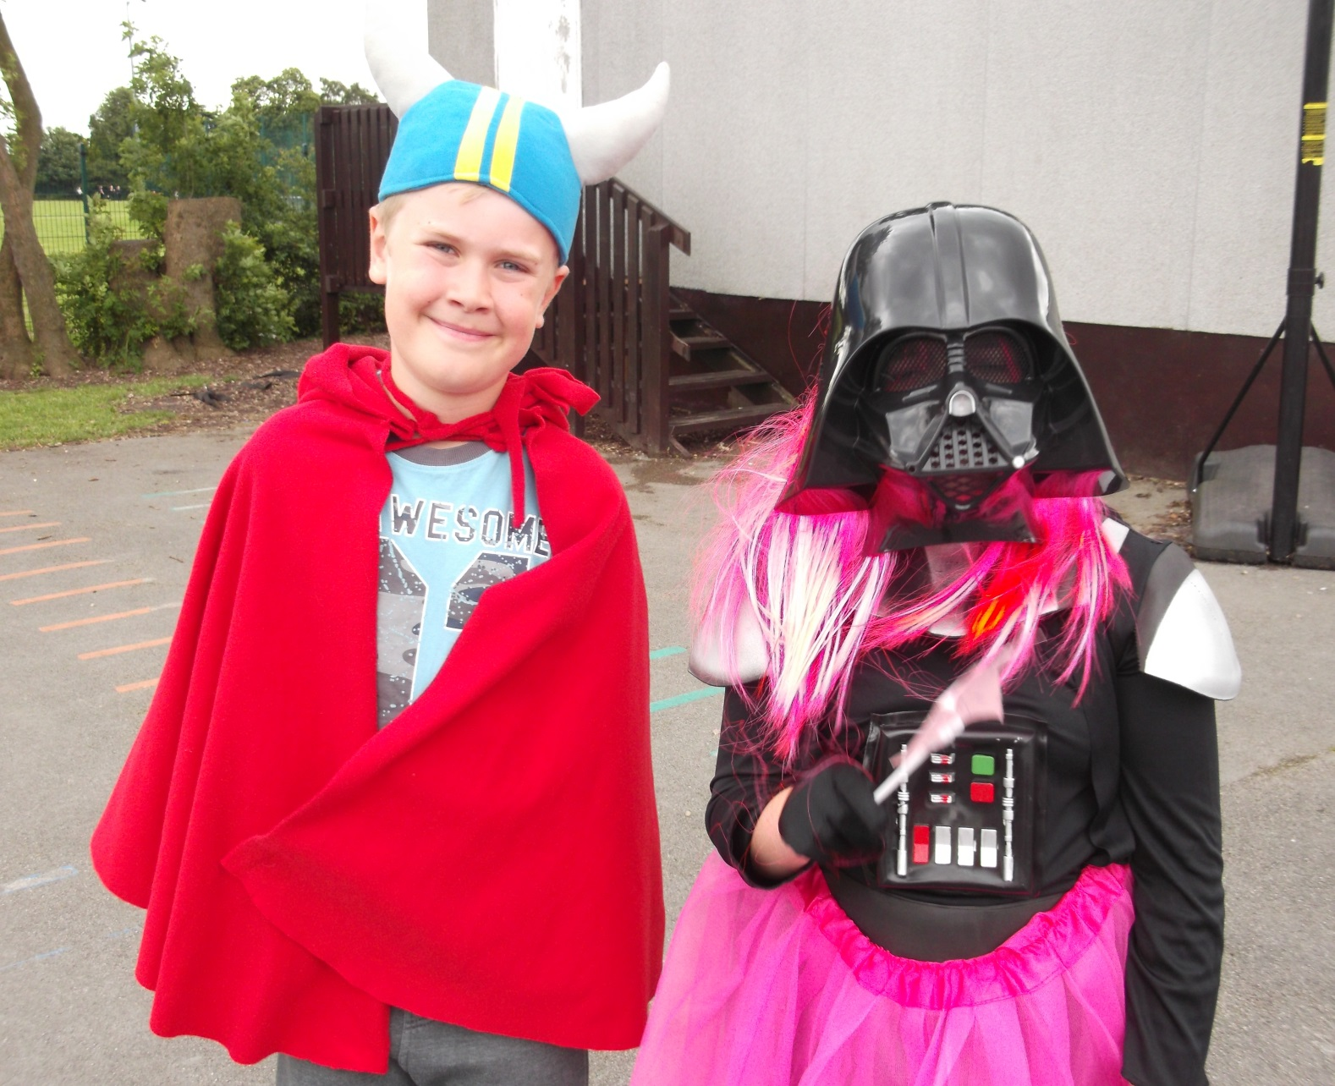
Do the Vikings still live in England ?
Yes they do !

Slide 16
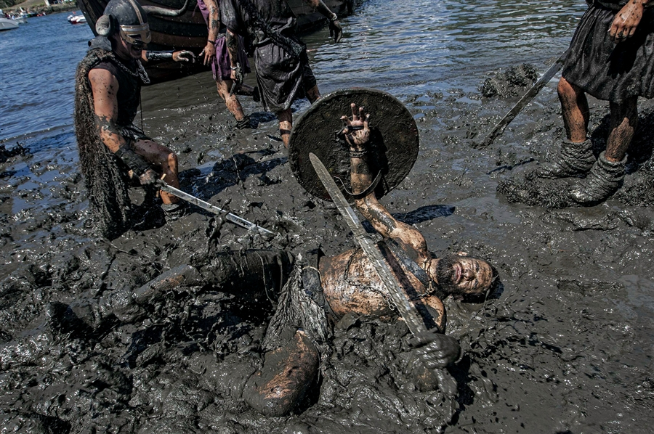
What language did the Vikings speak ?
dirt
dregs
rotten
muck
slaughter
mire
hit

Slide 17
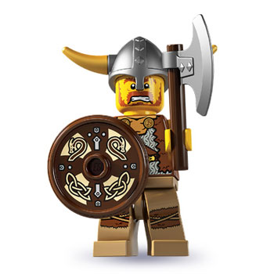
Did the Vikings play with Lego ?

Slide 18
Who were the Vikings ?
Raiders ?
Farmers ?
Warriors ?
Explorers ?
You decide !
Cold- blooded killers ?
Settlers ?
Traders ?

Slide 19
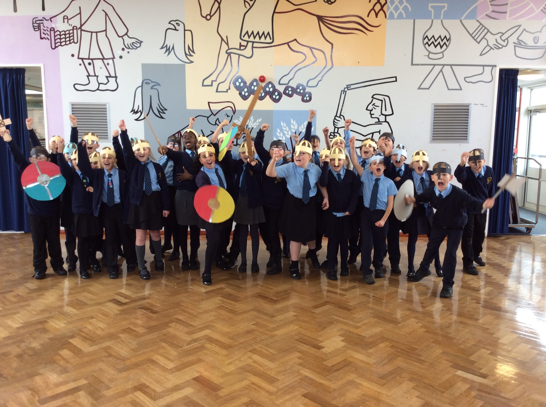
“Arrghh !”

