Slide 1
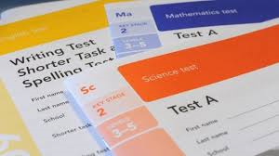
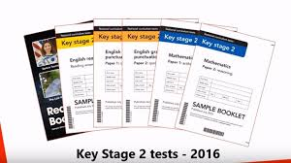
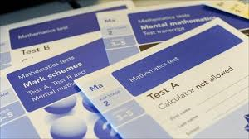
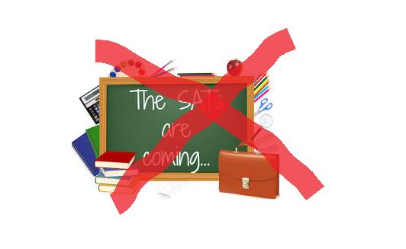

SATs

Slide 2
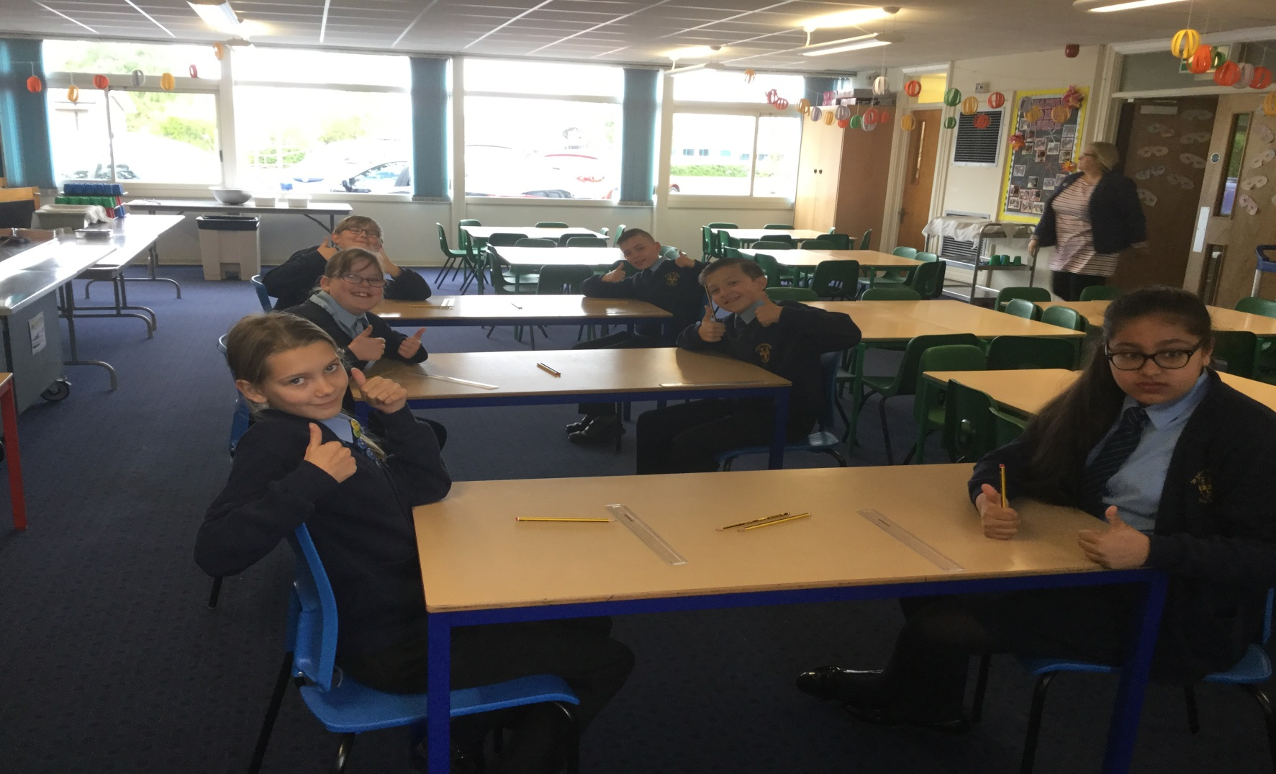

They made us look so happy… but in the end it was a fun experience!

Slide 3
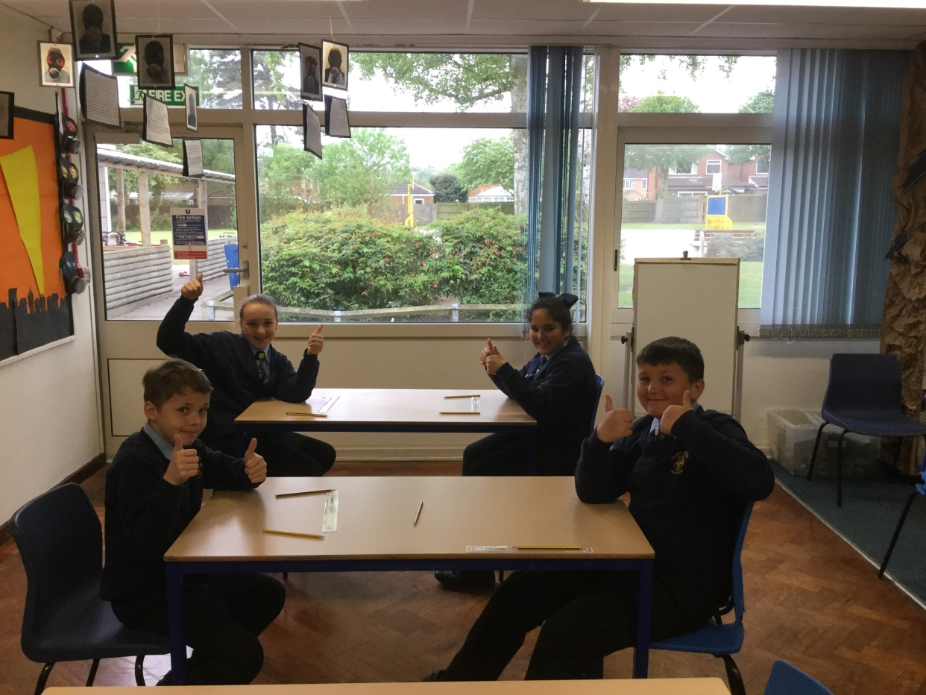

Didn’t think S.P.A.G made people so happy. The world is a weird place.

Slide 4
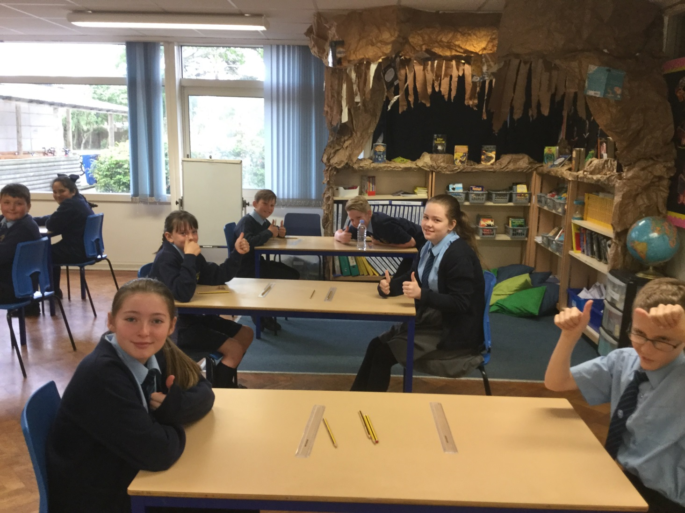

6KR in their natural habitat – working hard towards their dreams.

Slide 5
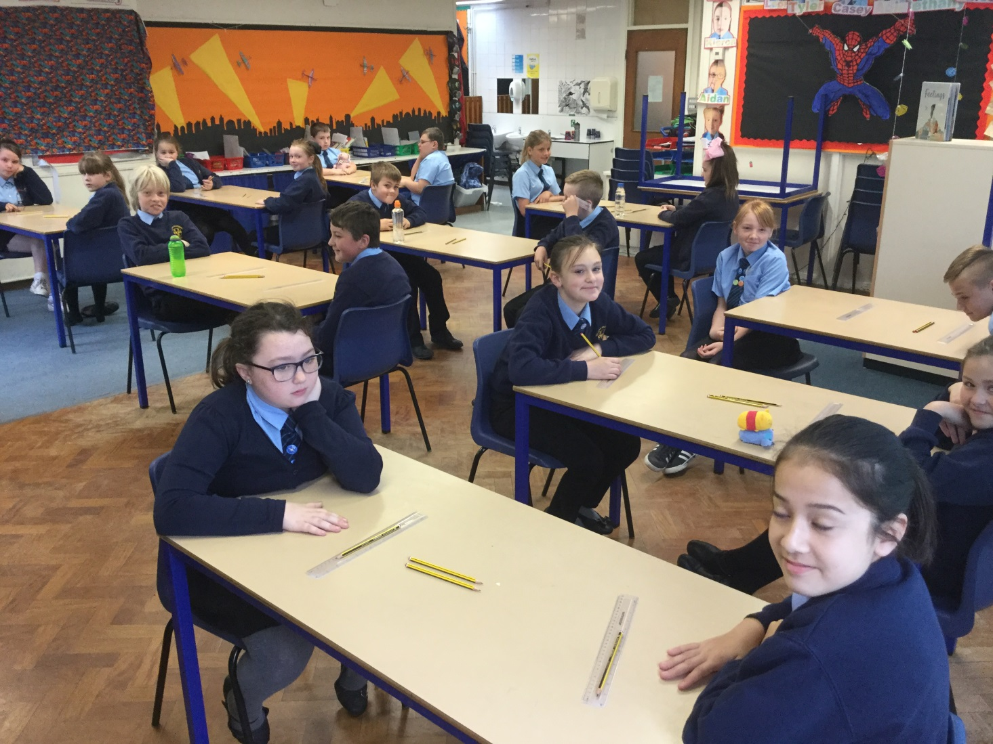
As you can see, it’s always a fun day in 6KR.

Slide 6
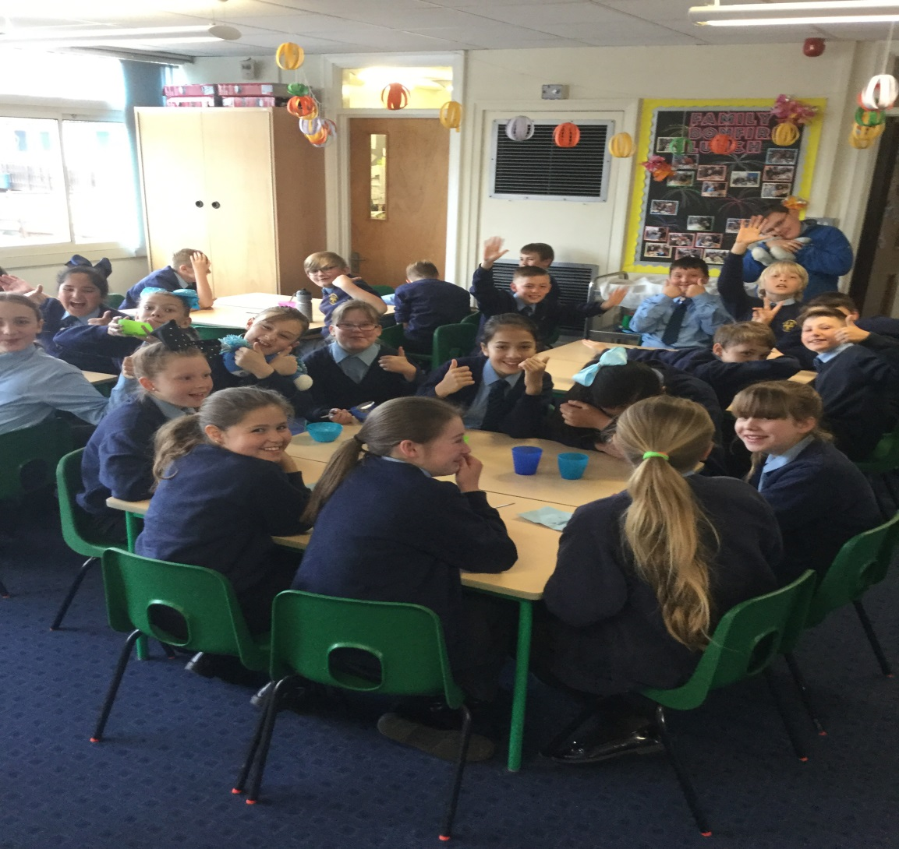

Breakfast club was the best part of the day .
Food, friends, fun and loads of banter.

Slide 7
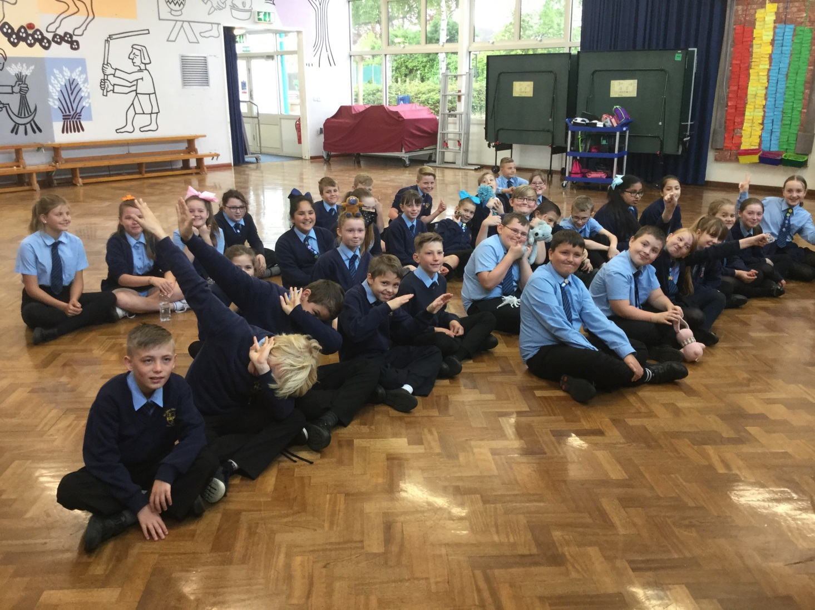


Preparing for a hard day’s work.

Slide 8
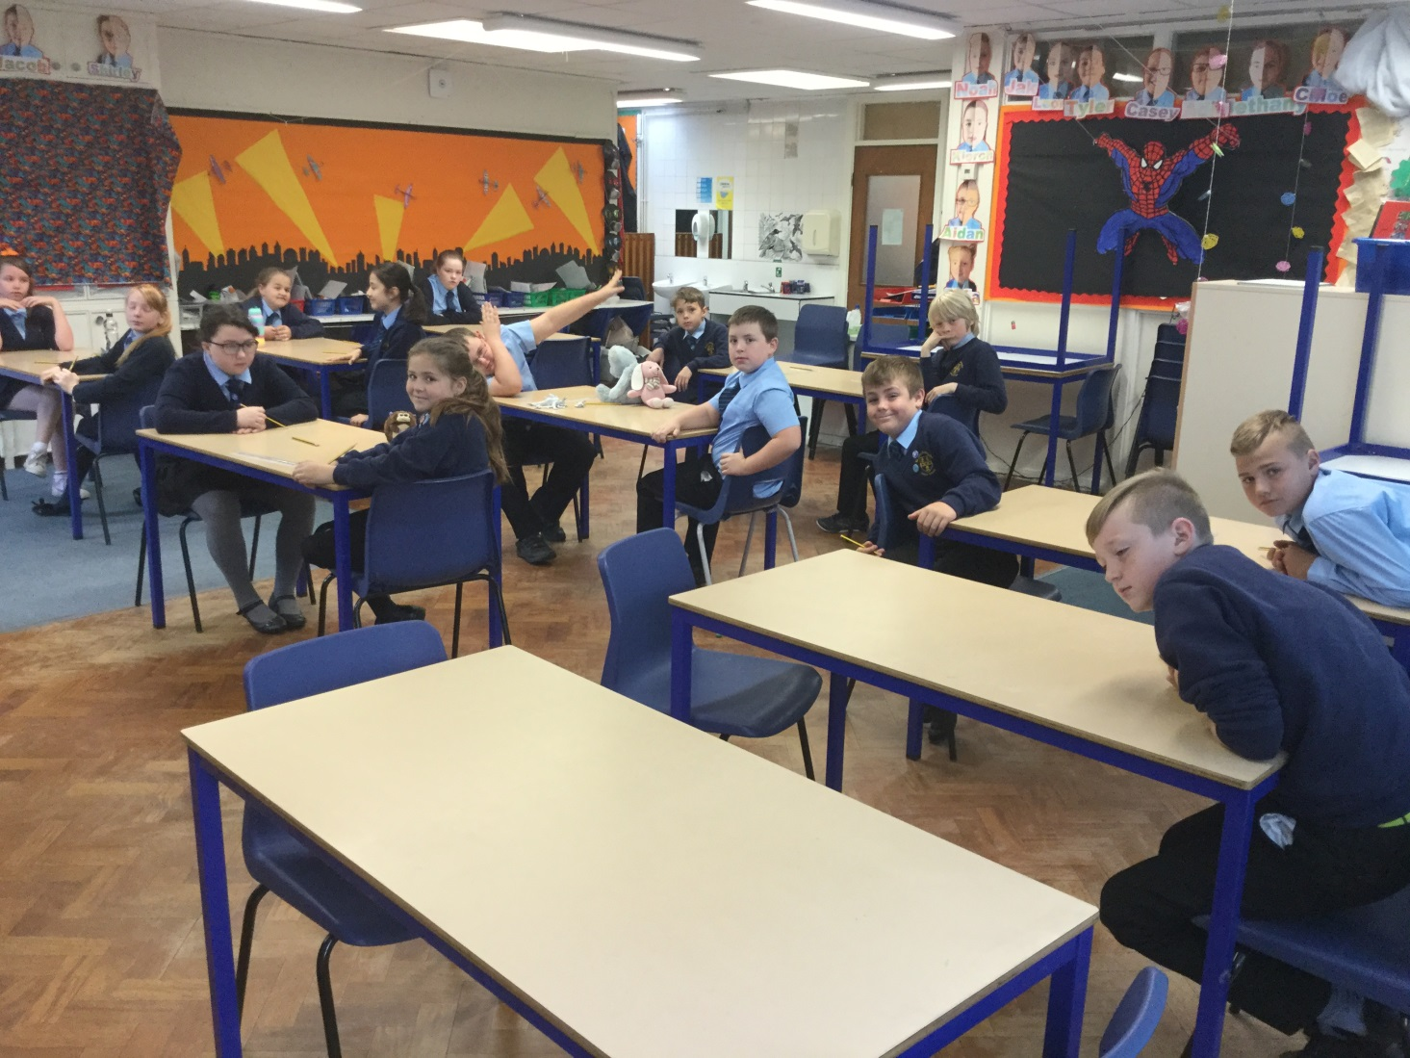
Finally finished the hardest day. It was soon over, thanks to the best teachers in the world!☺

Slide 9
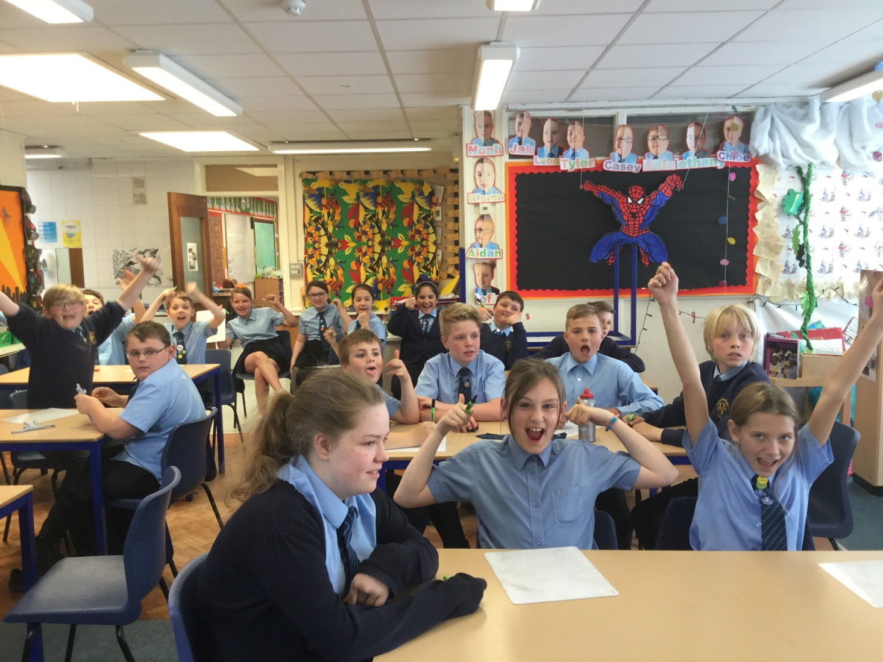

Celebratory cheer after SATs!!!!!

Slide 10
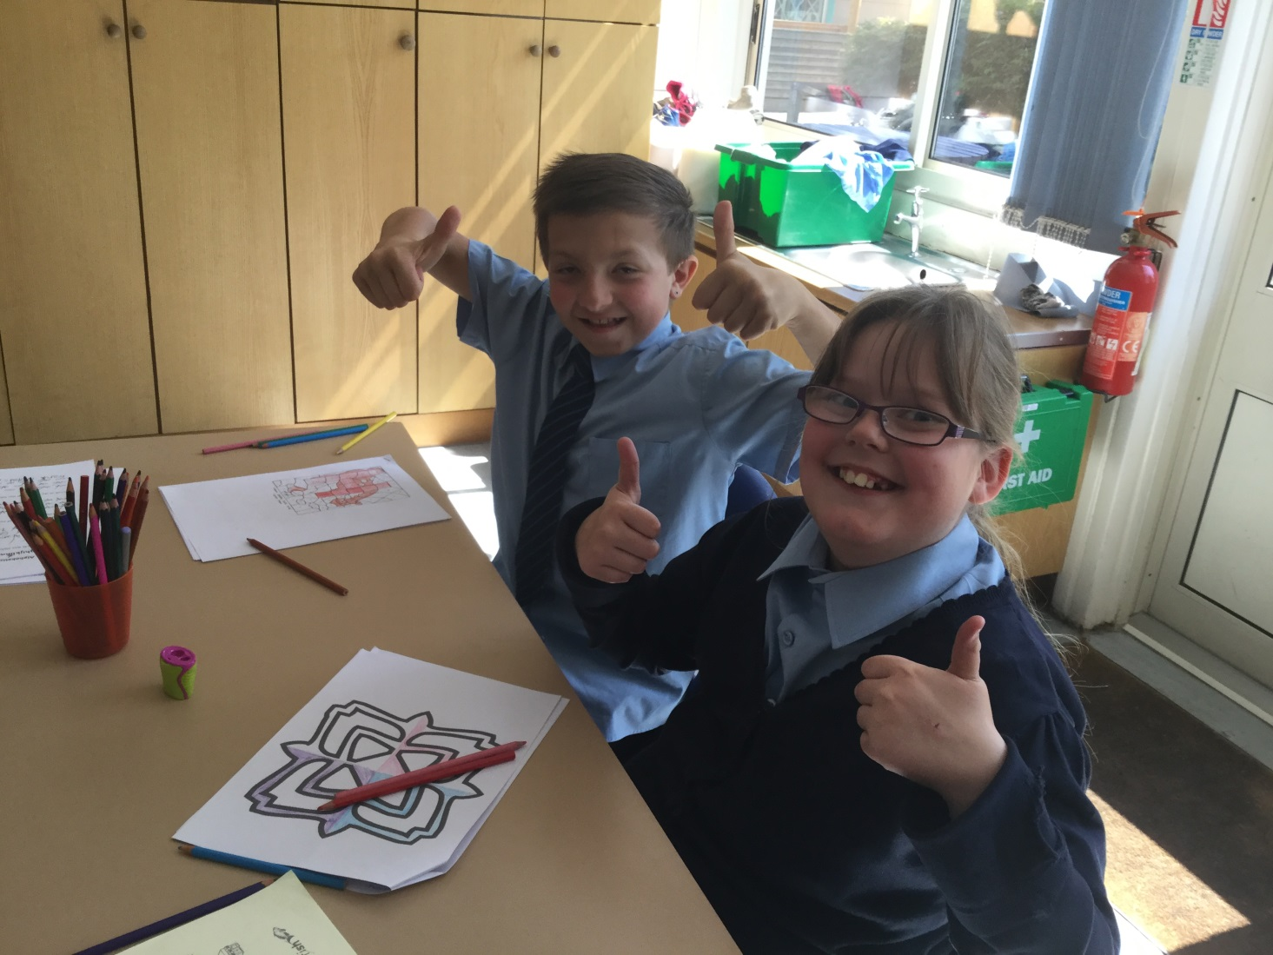
Tyler and Casey enjoying some down-time.

Slide 11
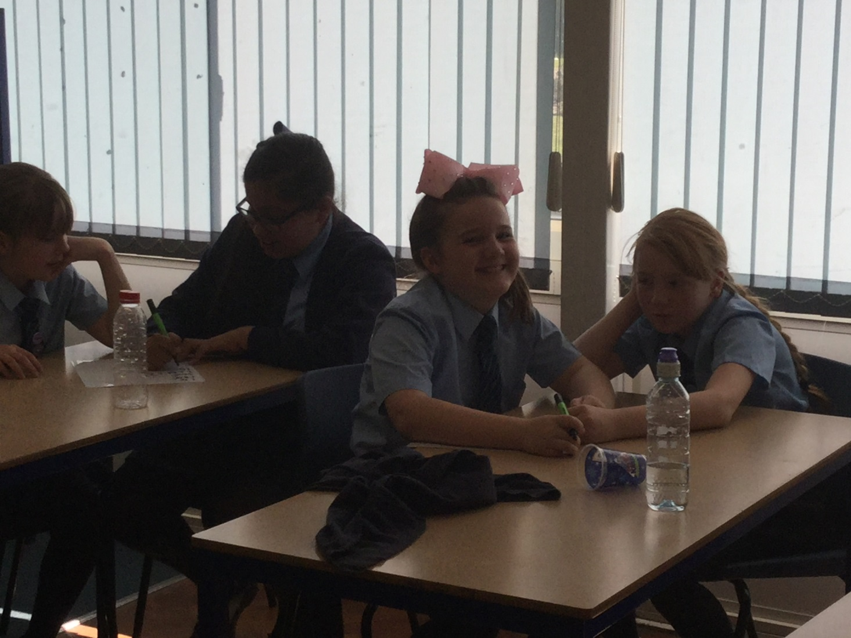
“I can’t take this anymore!” says Kacie.
“ Haha!!” is Bethany’s response.

Slide 12
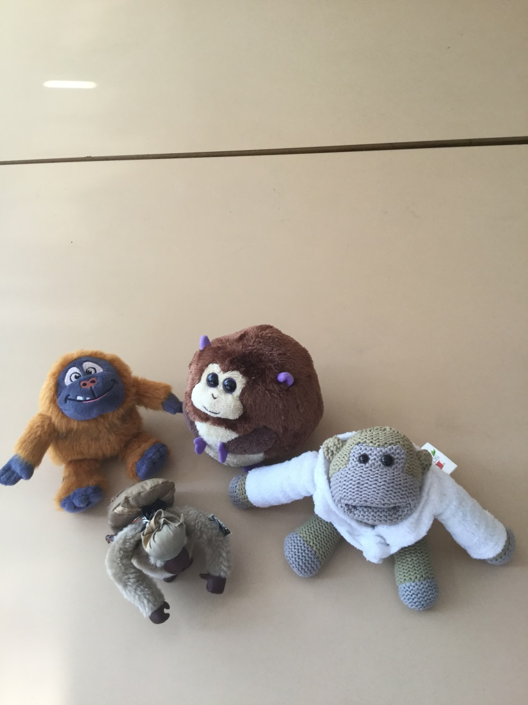
Our friendly mascots here to support us lads and girls.

Slide 13
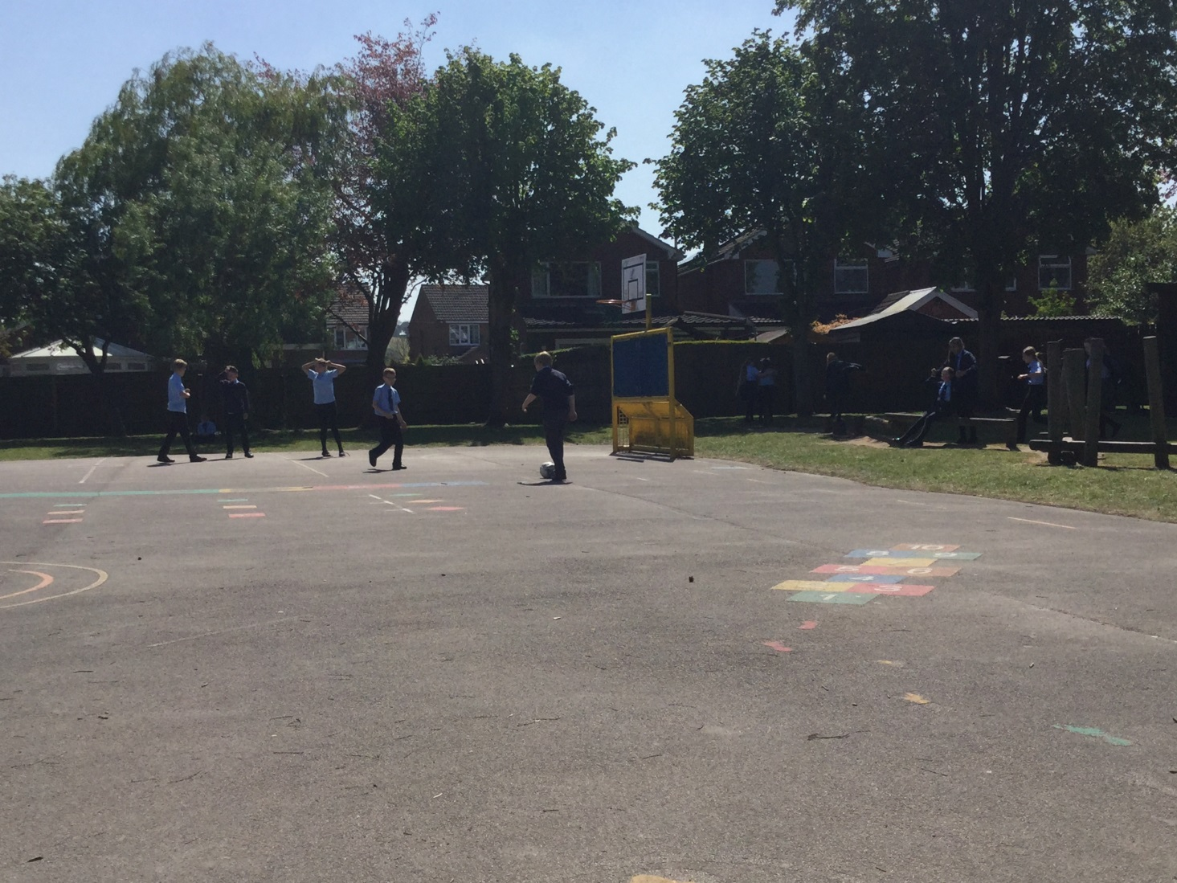
They even let us have a break during SATs!!

Slide 14
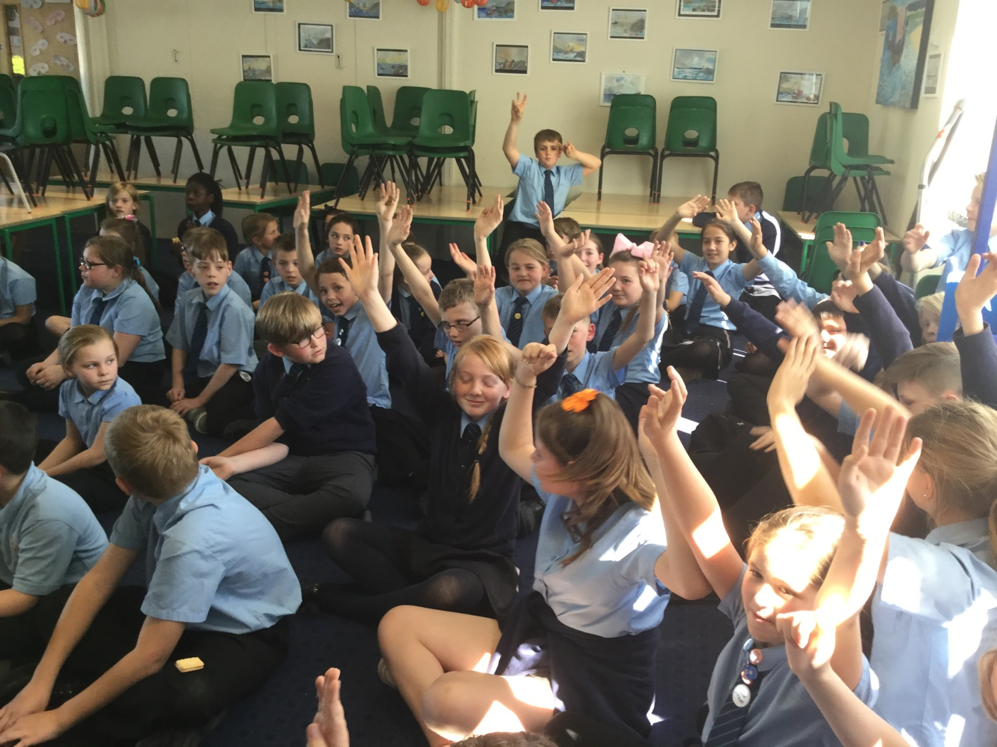
We even had time for a good, old singing session after a double-paper.

Slide 15
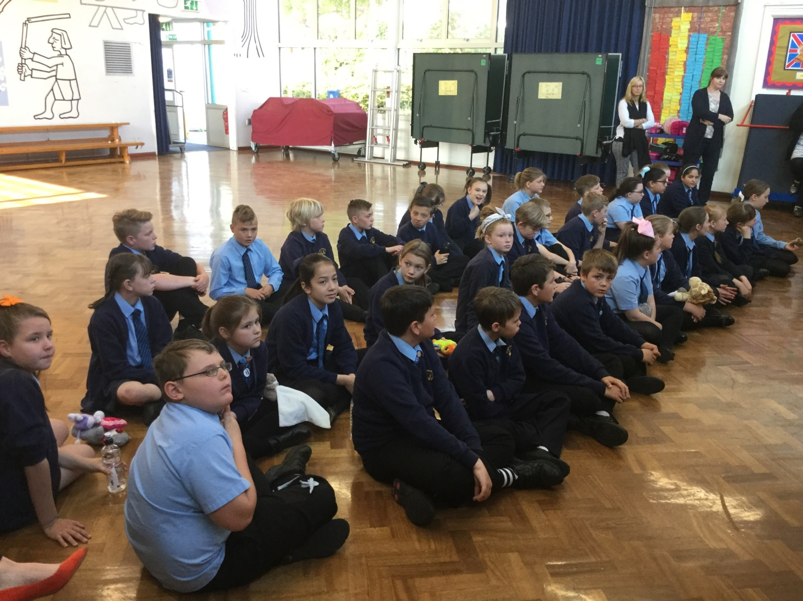


A good bit of encouragement from the friendly staff at SJS.

Slide 16
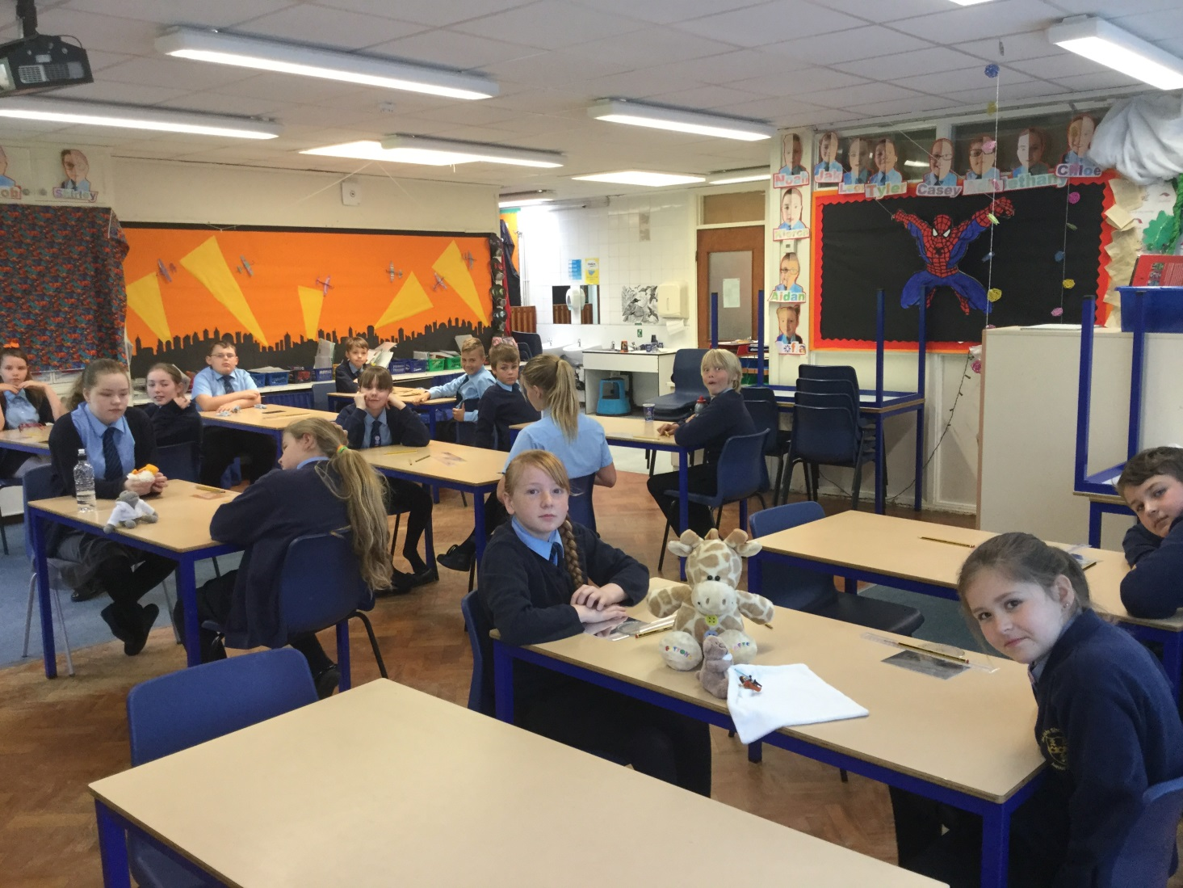
Last day of hard work for the foreseeable future. ☺
“That’s what you think,” whispers Mrs Rogers to Mrs Kimberley!!

Slide 17
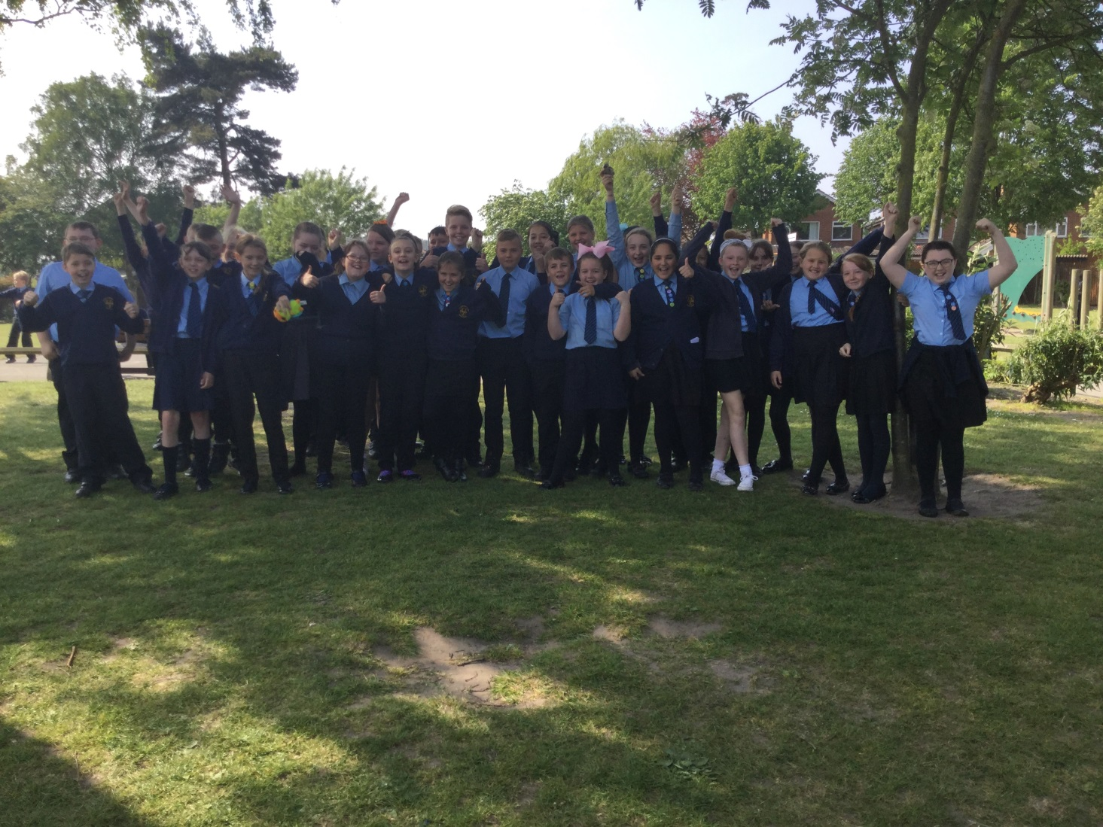


Thank goodness!!!It’s finally over until Monday. Ahhhhh!

Slide 18

WE ARE SO PROUD OF YOU YEAR 6!!

